Slide 1
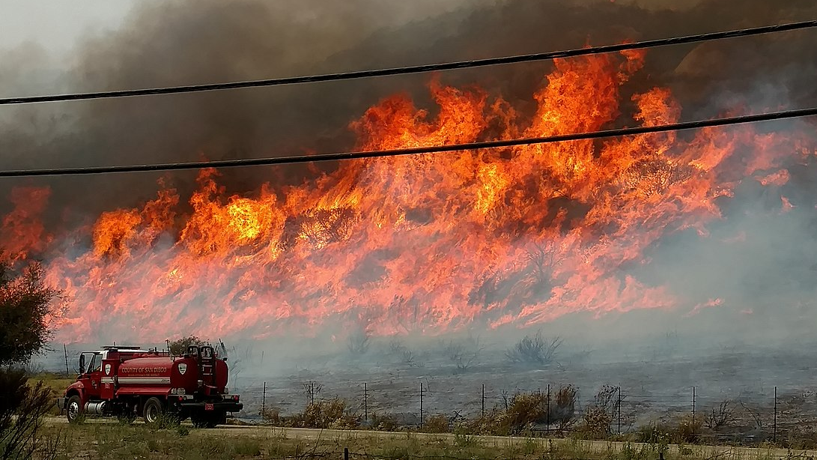
Fire Detection and Localization using Surveillance Camera
Dheeraj Reddy | 100811270 | - Tech lead
Purnima Yadav | 100800499
Ayush Parolia | 100799278
Ramesh Krishna | 100766763

Slide 2
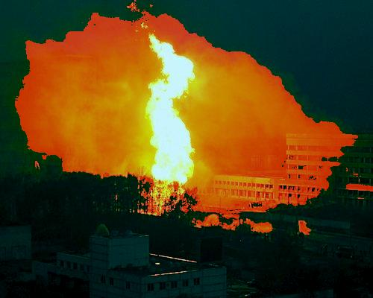
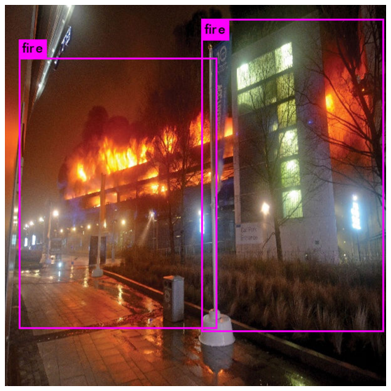
Motivation
From 2009 to 2018, there were 113,111 fires with loss reported to the OFMEM.
47% of these fires occurred in Residential occupancies.
27% occurred in vehicles.
13% occurred on structures/properties not classified by the Ontario Building code – this includes many non structure property types – land, outdoor storage, and some structures ranging from barns to weather stations.
5% of loss fires occurred in Industrial occupancies.
3% in Assembly occupancies.
2% in Mercantile occupancies
2% in Business and personal services occupancies.
1% in Care and detention occupancies.

Slide 3
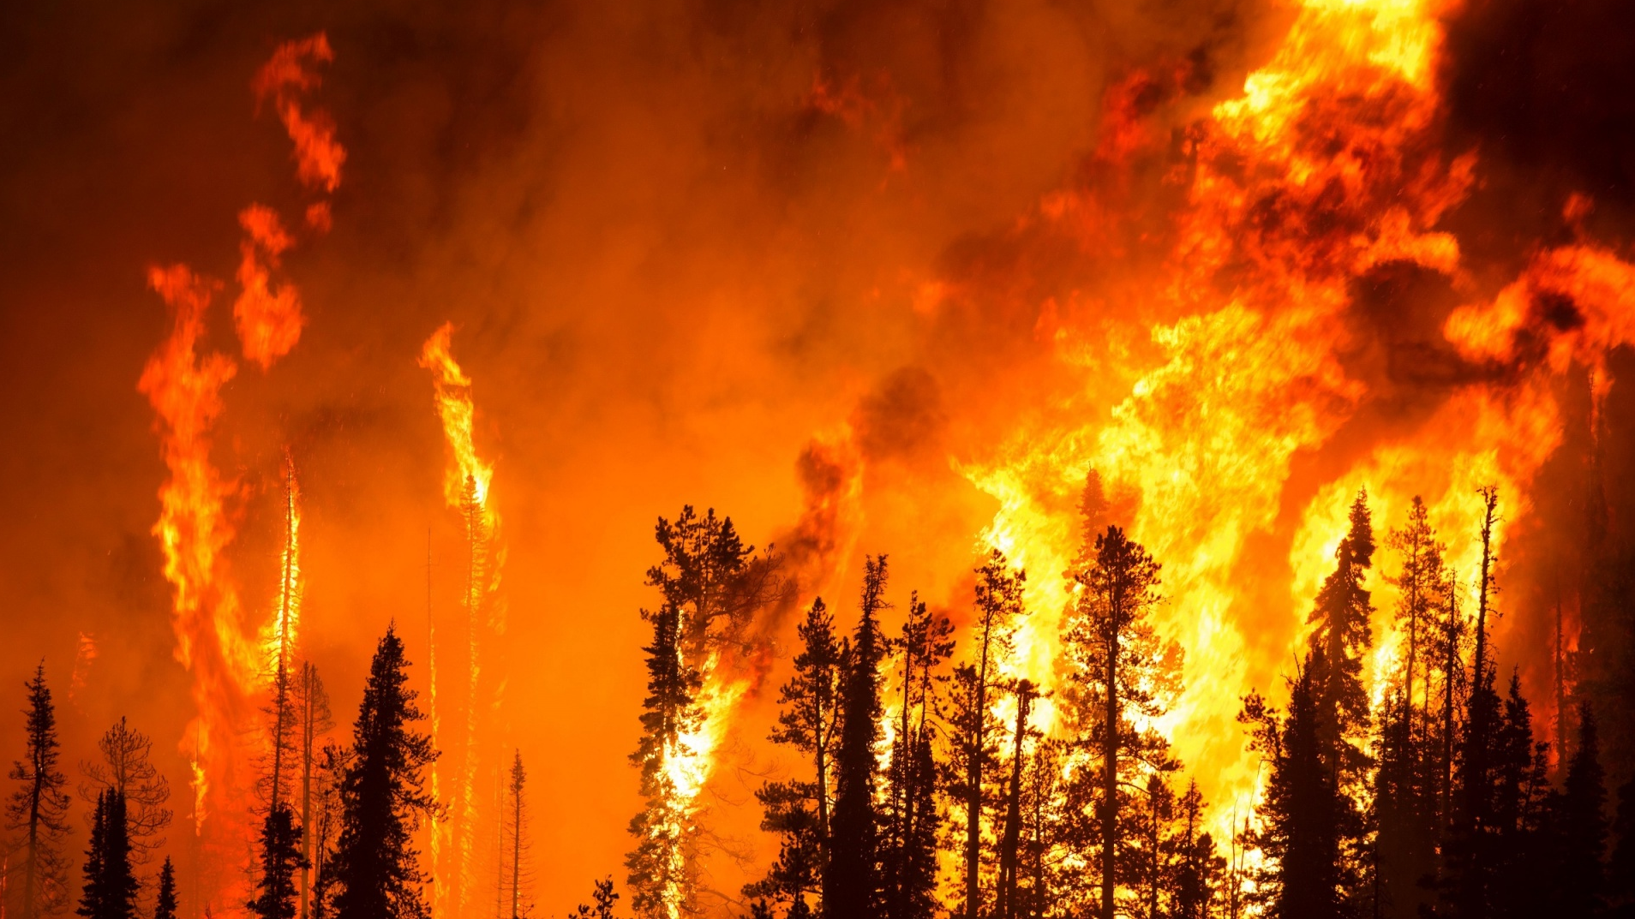
Project Deliverables
Trained Model to Detect Realtime Fires
Model Deployment on Mobile or Raspberry
Fire Simulation & Identification
Store incidents on a database.
Email groups to solve problems

Slide 4
Datasets and Localizing data
The datasets consists of different images and videos of fire.
But, the images and video frames have to be annotated and will be further used for model training.
Datasets:
http://smoke.ustc.edu.cn/datasets.htm
https://mivia.unisa.it/datasets/video-analysis-datasets/fire-detection-dataset/
https://www.kaggle.com/ankan1998/fire-detection-annotated-dataset/version/1

